Slide 1
Bellabeat Marketing Analysis:
Smart device usage
Presented by: Jacob Iratsor Idinye
Last updated: December 28th, 2023

Slide 2
Table of Contents
Introduction
Business Task
Data preparation
Data processing
Analysis
Marketing Recommendations
Limitations
Appendix

Slide 3
WHAT IS A SMART DEVICE?

Slide 4
Introduction
A smart device is any tool (wired or wireless) that is capable of connecting to other devices and performs simple or complex operations. E.g T.V remote, computer, phones, etc.
In this presentation, we will be focusing on smart device usage in the health sector.
Tools that help track patient data and use that information to administer treatment would be considered a smart device (Science Soft). A popular example is the Fitbit watch.

Slide 5

WHAT IS OUR BUSINESS TASK?

Slide 6
Business Task
Bellabeat, a high-tech manufacturer of health-focused products for women.
As a new marketing analyst at Bellabeat, i was tasked with creating a marketing strategy for the Bellabeat leaf fitness tracker.
The leaf acts as a bracelet, necklace, or clip and can applied on any part or extension of its user.
Using results/findings from analysing datasets of smart device usage, i was able to make recommendations.

Slide 7
HOW WAS DATA COLLECTED?

Slide 8
Data preparation
For this analysis, i used 2 data sets.
FitBit Fitness Tracker Data (CC0: Public Domain, dataset made available through Mobius) was retrieved from Kagle.
Norway dataset Smart device usage from January 2019 to December 2020.
Both datasets were excel/csv files in long format.
I used both datasets to eliminate population bias - 1st dataset had 33 unique ID’s, 2nd dataset had 113 unique IDs.
Contents of each dataset contained tracked health data. They are as follows:
Step count per day/per hour
Calorie expenditure per day/ hour
3 categories of physical activities ( light, fair and vigorous physical activities per day)
*Datasets below were only applicable for the FitBit Fitness Tracker Data set
Sleep activity per day/minute
Stress level ( Heart rate value) per second
Notes:
Both datasets had multiple csv files on Step count, Calorie, Physical activities in multiple formats - day/ hour/ minute.
Norway dataset did not have csv files on sleep and stress level.
Norway dataset had 2 csv files ( raw and analysed) - For our analysis, we only used the raw dataset as it in long data format categorised per day.

Slide 9
HOW WAS DATA CLEANED AND PROCESSED?

Slide 10
Data Processing
For both datasets, I changed the name ( included units of measurements, acronyms, and naming schema) and adjusted the data type ( date, time, numerical, string ) of each column in Excel.
I revised versions of the Norway raw dataset into 2:
1. This excel sheet contains participants IDs, provider ( Fitbit or Garmin), and total number of steps on each day.
2. The excel sheet contains columns for participant IDs, providers ( Fitbit or Garmin), Sedimentary time (i.e sitting, idle.) measured in minutes, 3 categories of physical activities measured in minutes, and calorie expenditure measured in Kcal (kilocalories).
I combined both FitBit Fitness Tracker Data sets and Norway dataset Smart device usage in SQL. Using the Union function and Join function

Slide 11
ANALYSING OUR DATA IN SQL

Slide 12
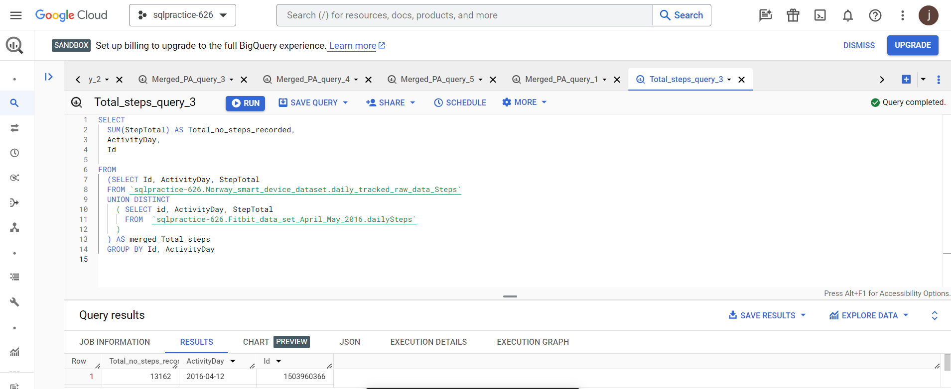
Analysis
I used the UNION DISTINCT function on SQL to combine the Fitbit dataset and Norway dataset together. This merged both datasets, making sure duplicates were removed from the final result.

Slide 13
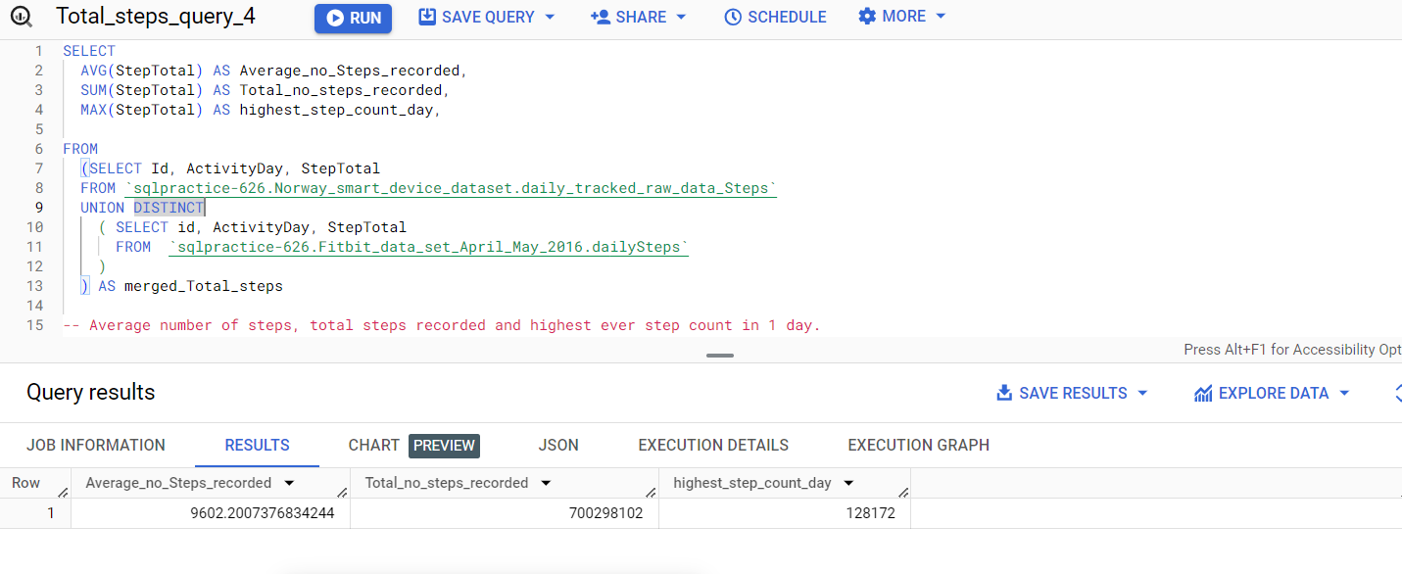
Analysis
Summary data shows 700,298,102 total steps were recorded, with a total average of 9,602.20 steps.

Slide 14
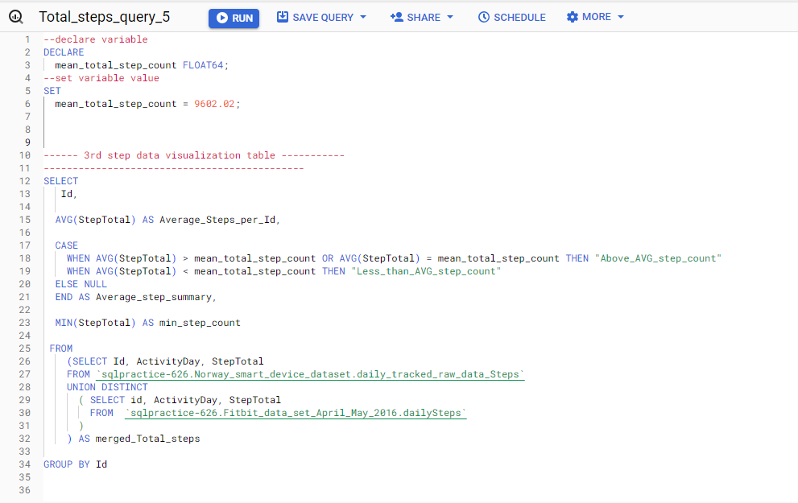
Analysis
61 out of 146 participants recorded average step counts higher than the mean average step count for all participants (9,602.02). 41.8% participants recorded higher average steps than the overall average for all steps among all participants.

Slide 15
Aggregate Sedimentary time,
Step count & Calorie expenditure over time

Slide 16
SEASONAL

Slide 17
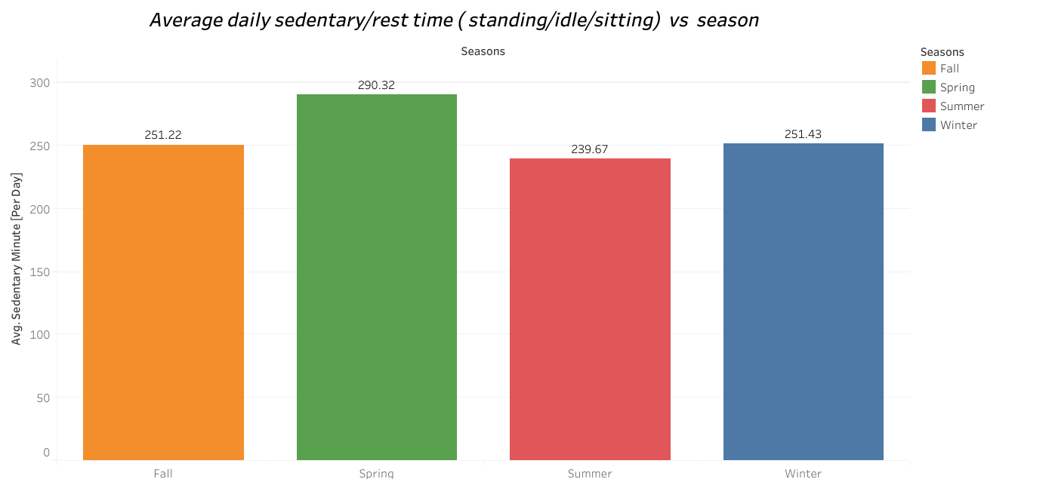
Analysis
SEASONAL - sedentary
Sedentary time was highest during Spring and lowest during the Summer.
Participants averaged 290.32 minutes (4:50:18) during spring, and 239.67 minutes( 4: 11 : 12 ) during summer.
Notes:
Sedentary category recognises time in which participants are either sitting, standing, or being idle - not to be confused with sleeping.

Slide 18
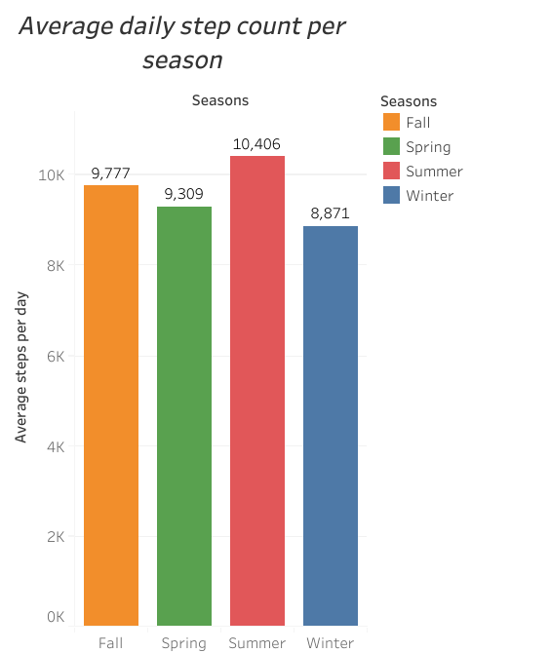
Analysis
SEASONAL - steps
Participants recorded the most steps during Summer, and least during Winter.
Participants averaged 10, 406 daily steps during Summer, and 8, 871 daily steps during Winter.

Slide 19
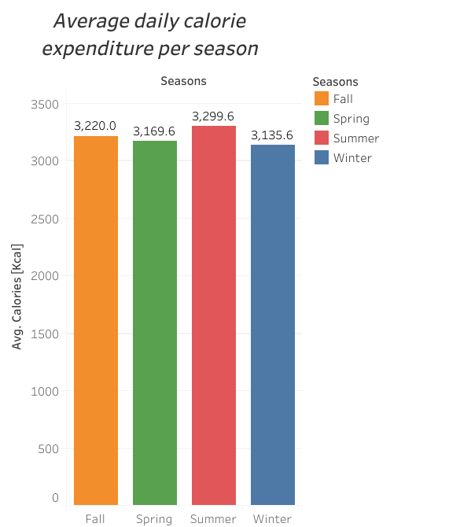
Analysis
SEASONAL - calories
Participants lost the most calories during Summer, and least during Winter.
Participants averaged 3,299.63 kilocalories during Summer, and 3,135.61 kilocalories during winter.

Slide 20
MONTHLY

Slide 21
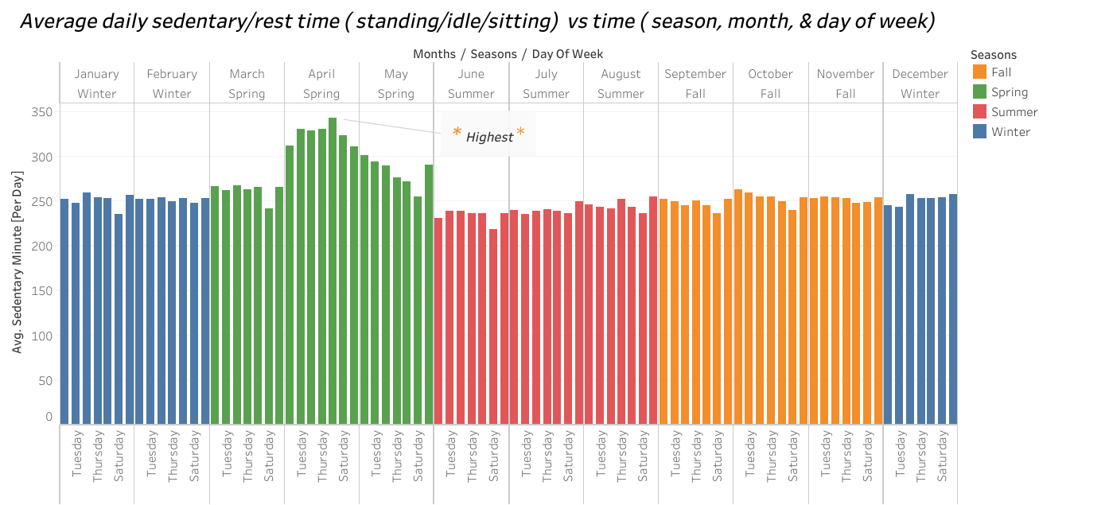
Analysis
MONTHLY - sedentary
Sedentary time was highest in April, and lowest in lowest in June .
Participants averaged 325.46 minutes (05:25:27) in April, and 233.66 minutes (03:53:39) in June.

Slide 22
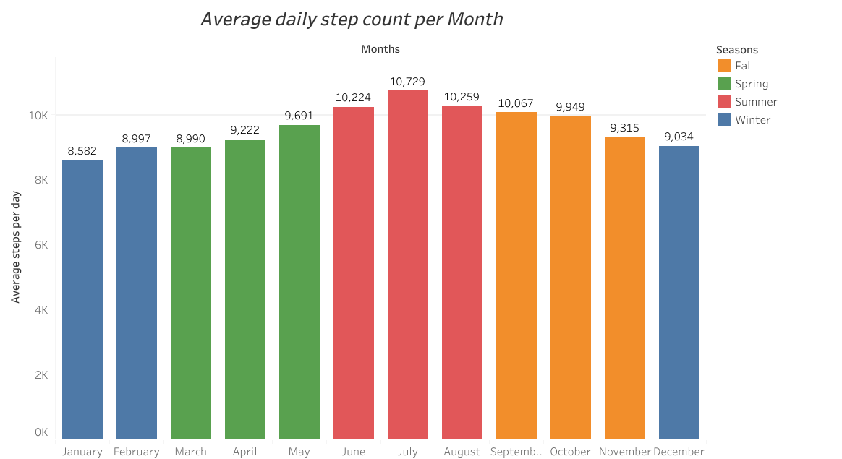
Analysis
MONTHLY - steps
Participants recorded the most steps in July, and the least in January.
Participants averaged 10, 729 daily steps in July, and 8, 582 steps daily in January.

Slide 23
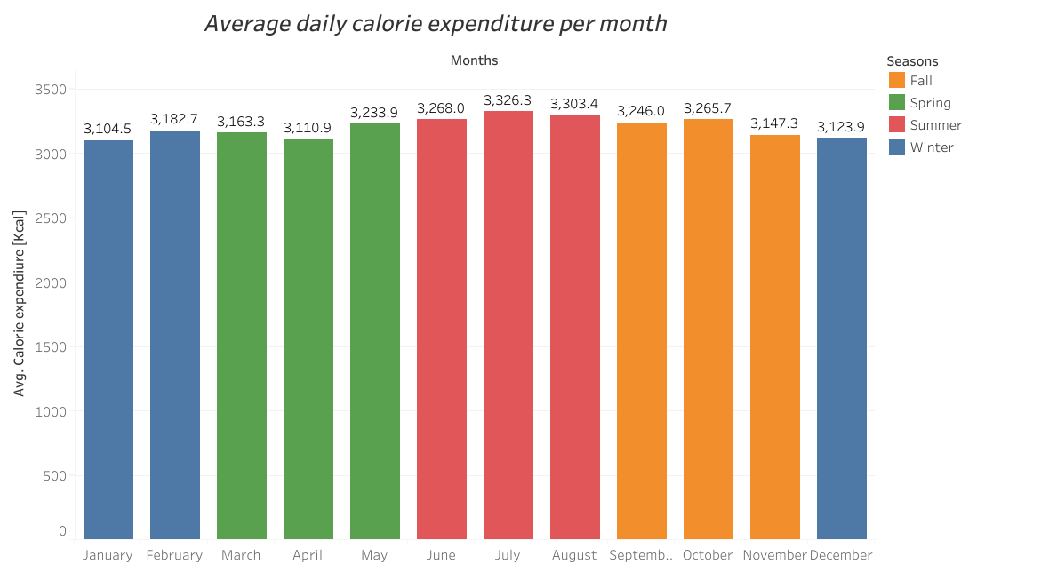
Analysis
MONTHLY - calories
Participants lost the most calories in July, and least during January.
Participants averaged 3,326.3 kilocalories in July, and 3,104.5 kilocalories in January.

Slide 24
DAILY

Slide 25
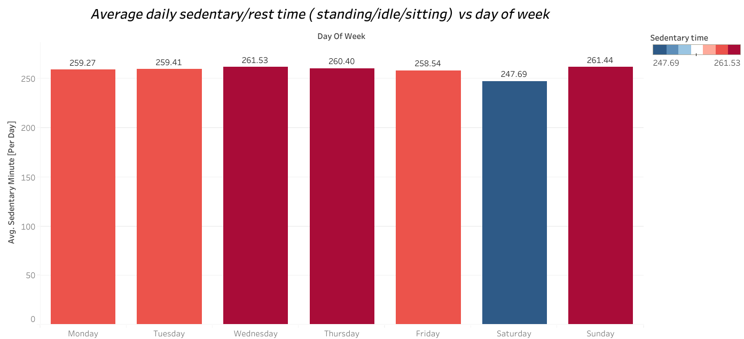
Analysis
DAILY -sedentary
Sedentary time was highest on Wednesdays, and lowest in lowest on Saturdays .
Participants averaged 261.52 minutes (04:21:31) on Wednesdays, and 247.68 minutes(04:07:40) on Saturdays.

Slide 26
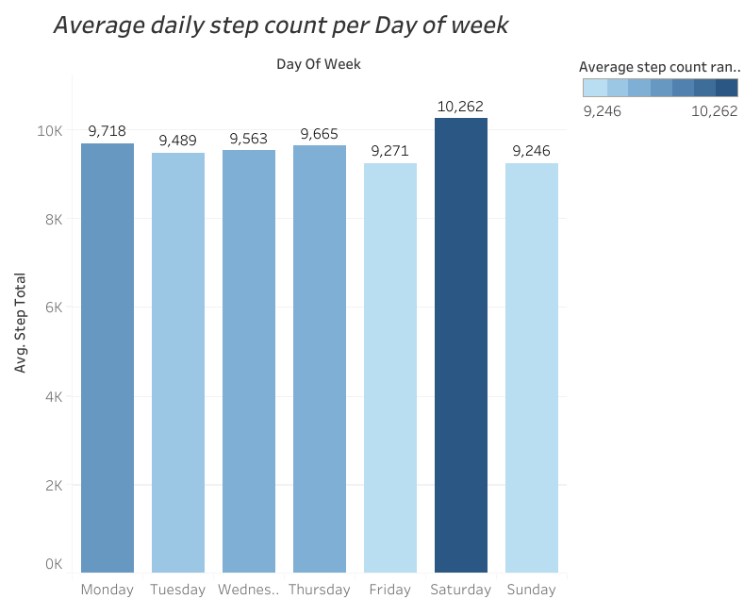
Analysis
DAILY - steps
Participants recorded the most steps on Saturdays, and the least on Sundays.
Participants averaged 10, 262 daily steps on Saturdays, and 9, 246 steps daily on Sundays.

Slide 27
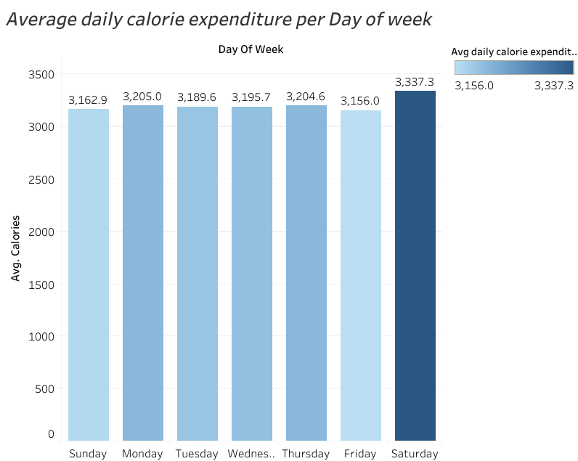
Analysis
DAILY - calories
Participants lost the most calories in Saturdays, and the least on Fridays.
Participants averaged 3,337.3 kilocalories on Saturdays, and 3,156 kilocalories on Fridays.

Slide 28
TIME OF DAY

Slide 29
LEGEND
Morning : 6:00 AM TO 12: 00 noon
Afternoon : 12: 00 noon TO 6: 00 PM
Evening : 6:00 PM TO 9:00 PM
Night : 9:00 PM TO 6:00 AM

Slide 30
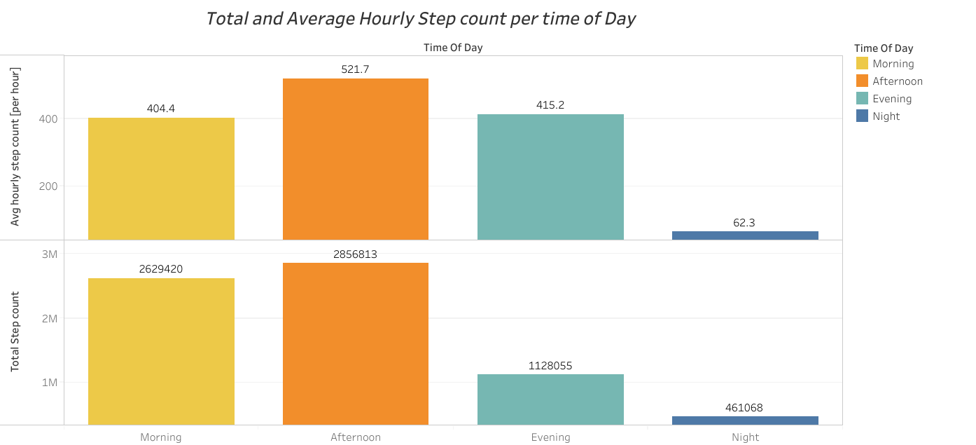
Analysis
TIME OF DAY - steps
Participants recorded the most steps in the Afternoon, and the least on Night.
Participants averaged 521.7 steps/hr in the Afternoon, and 62.3 steps/ hr at Night.

Slide 31
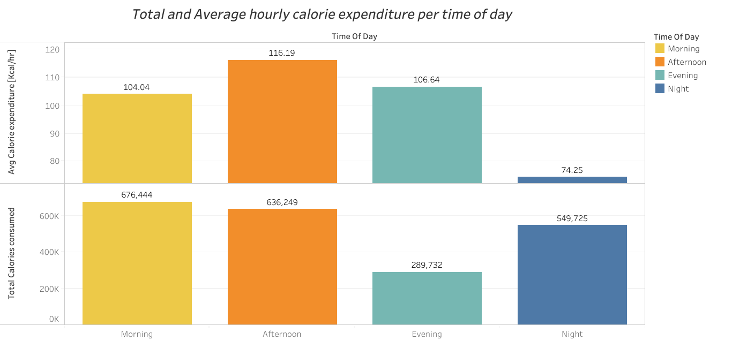
Analysis
TIME OF DAY - calories
Participants lost the most calories in Afternoon , and the least on Night.
Participants averaged 3,337.3 kilocalories/hr in the Afternoon, and 3,156 kilocalories/hr at Night.

Slide 32
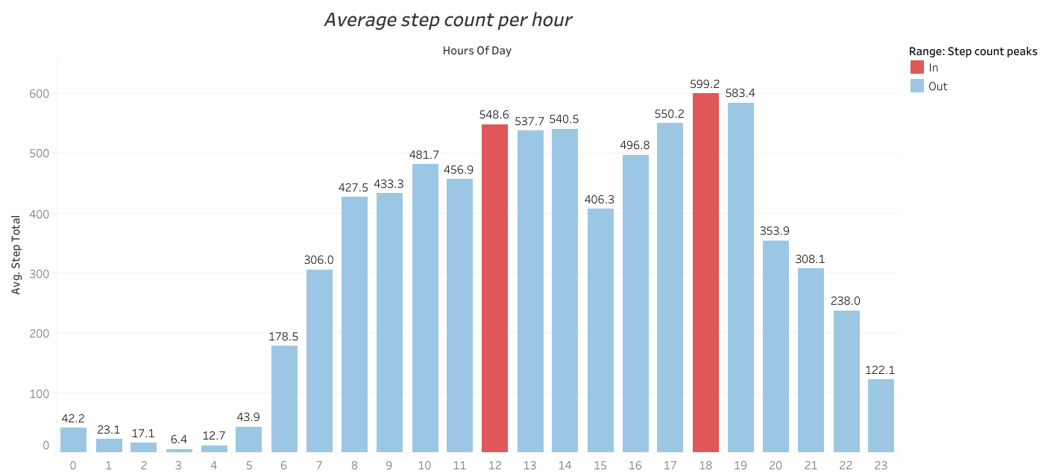
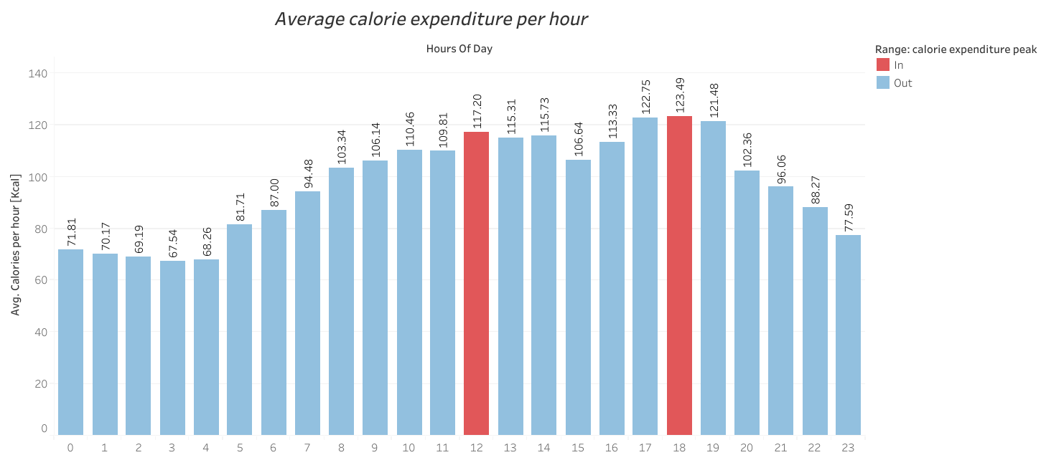
TIME OF DAY - calories
Throughout the course of a day (24 hours), step count and calorie expenditure peaked at 12:00 PM noon and 6:00 PM.

Slide 33
Aggregate 3 categories of Physical activities over time

Slide 34
SEASONAL

Slide 35
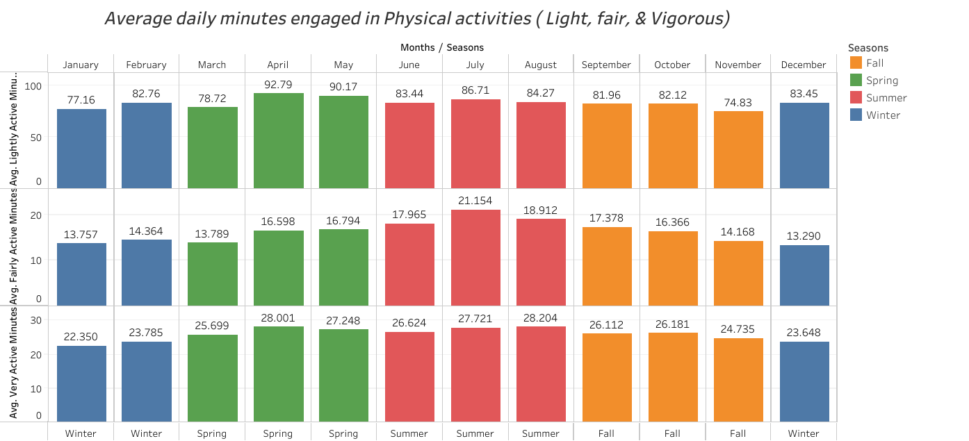

Slide 36
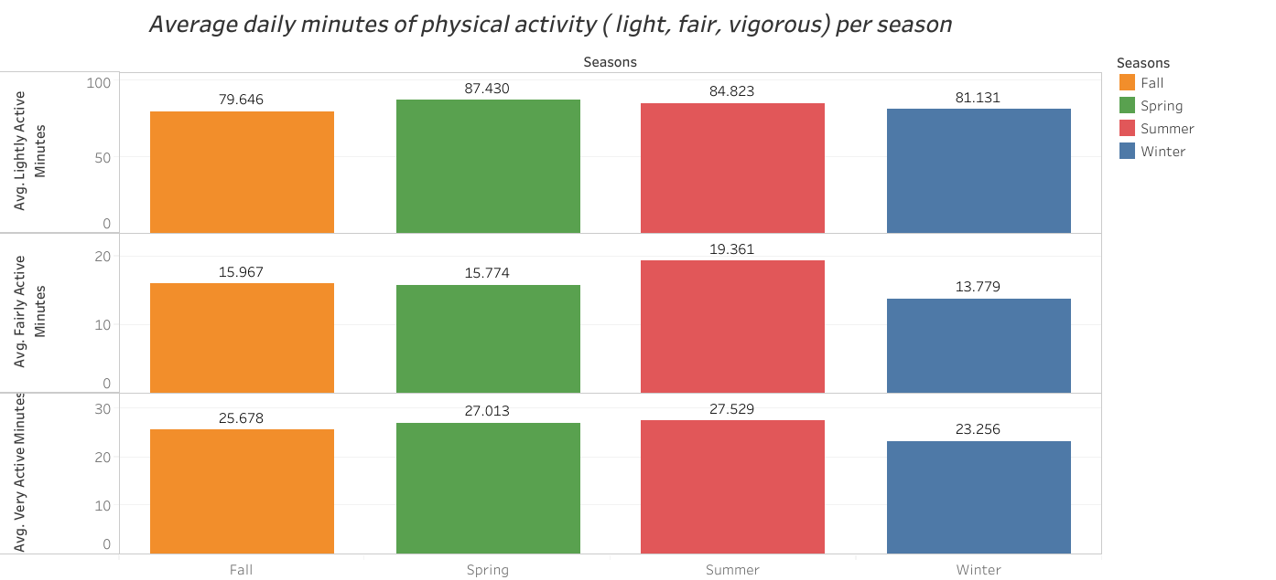
Analysis
SEASONAL
Participants spent the most time engaged in light physical activities during Spring. The least time was spent during fall.
Participants averaged 87.430 minutes (01:27:31) daily during spring, and 79.646 minutes (01:19:38) daily during fall.

Slide 37
Analysis
SEASONAL
Participants spent the most time engaged in fairly physical activities during Summer. The least time was spent during winter.
Participants averaged 19.361 minutes (00:19:37) daily during Summer, and 13.779 minutes (00:13:46) daily during winter.

Slide 38
Analysis
SEASONAL
Participants spent the most time engaged in vigorous physical activities during Summer The least time was spent during winter.
Participants averaged 27.529 minutes (00:27:31) daily during summer, and 23.256 minutes (00:23:15) daily during winter.

Slide 39
MONTHLY

Slide 40
Analysis
MONTHLY
Participants spent the most time engaged in light physical activities during April The least time was spent during November.
Participants averaged 92.79 minutes (01:32:46) daily during April, and 74.83 minutes (01:14:49) daily during November.

Slide 41
Analysis
MONTHLY
Participants spent the most time engaged in fairly physical activities during July The least time was spent during December.
Participants averaged 21.154 minutes (00:21:09) daily during July, and 13.290 minutes (00:13:17) daily during December.

Slide 42
Analysis
MONTHLY
Participants spent the most time engaged in vigorous physical activities during August The least time was spent during January.
Participants averaged 28.204 minutes ( 00:28:12 ) daily during summer, and 22.350 minutes (00:22:20) daily during January.

Slide 43
DAILY

Slide 44
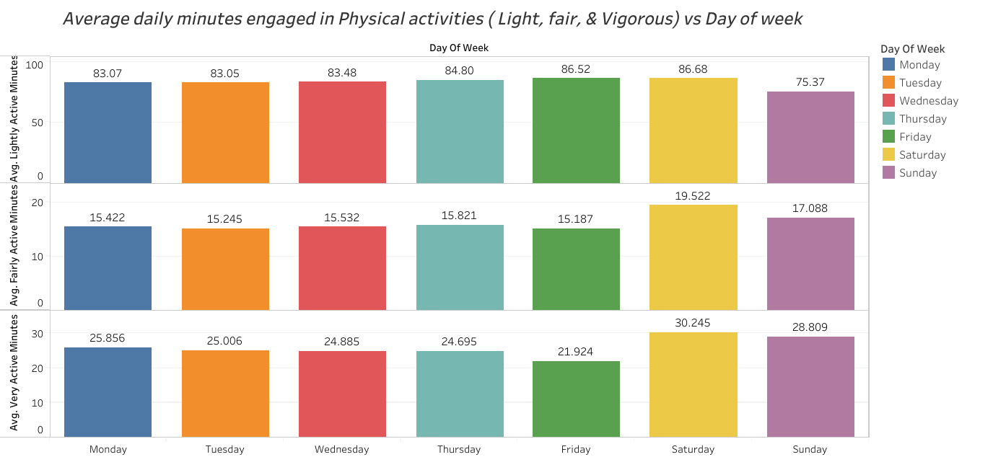
Analysis
DAILY
Participants spent the most time engaged in light physical activities on Saturdays. The least time was spent during Sundays.
Participants averaged 86.68 minutes (01:27:40) daily during Saturdays, and 75.37 minutes (01:15:22) daily during Sundays.

Slide 45
Analysis
DAILY
Participants spent the most time engaged in fairly physical activities on Saturdays. The least time was spent during Fridays.
Participants averaged 19.522 minutes (00:19:31) daily during Saturdays, and 15.187 minutes (00:15:17) daily during Fridays.

Slide 46
Analysis
DAILY
Participants spent the most time engaged in vigorous physical activities on Saturdays. The least time was spent during Fridays.
Participants averaged 30.425 minutes (00:30:20) daily during Saturdays, and 21.924 minutes (00:21:55) daily during Fridays.

Slide 47
Is there correlation between
Step count, Calorie expenditure, and 3 categories ( light, fair, and vigorous) of Physical activity?

Slide 48
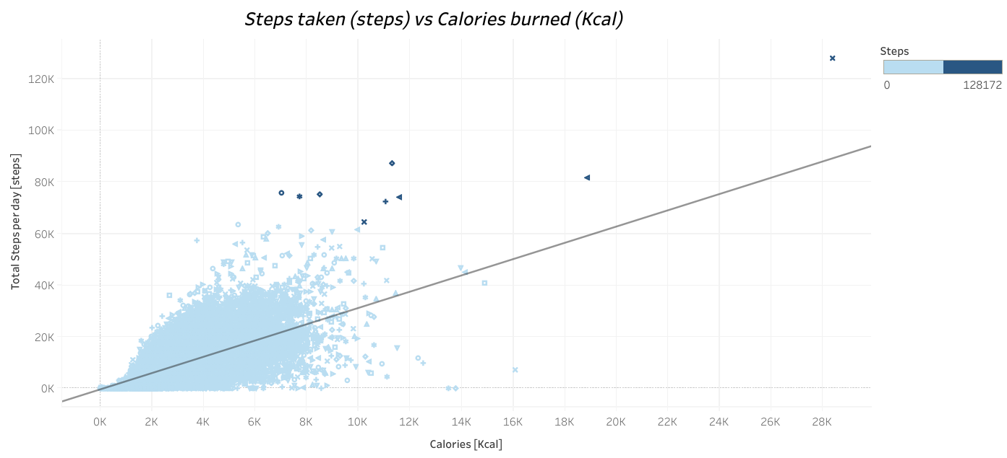
Analysis
Notes:
R-squared represents correlation coefficient - It ranges from -1 to 1, which negative values indicating negative correlation, and positive values indicating positive coreelations.

Slide 49
Analysis
There was positive correlation between step count and calorie expenditure.
The correlation coefficient was 0.6730.
We can infer the more steps taken the more calorie expenditure occurs.

Slide 50
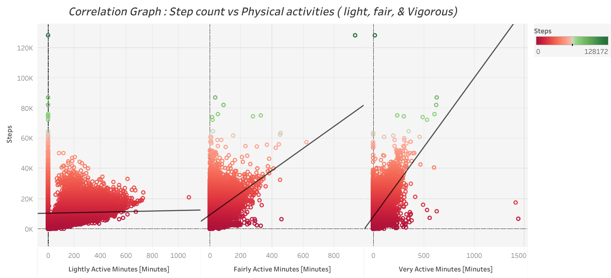

Slide 51
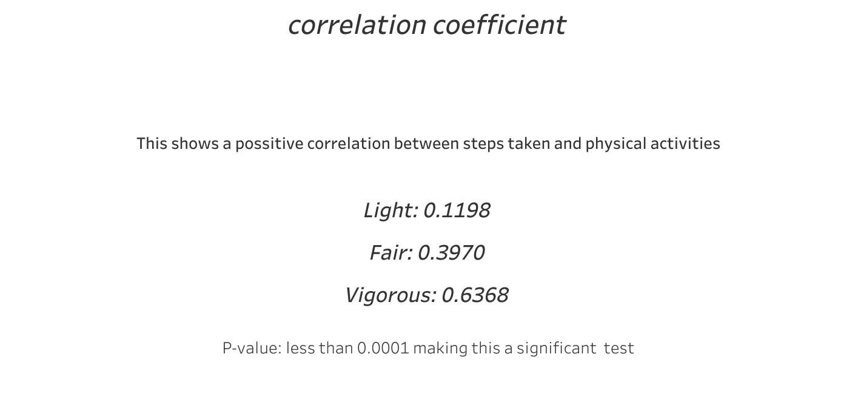
Analysis
There was positive correlation between step count and all 3 categories of physical activities.
The correlation coefficient for light physical activity and step count was 0.1198 - weak.
The correlation coefficient for fair physical activity and step count was 0.3970 - weak.
The correlation coefficient for vigorous physical activity and step count was 0.6368 - good.
Strength of correlation increases with difficulty.
We can infer an increase in time spent during physical activity can lead to an increase in steps count .
Notes:
Light physical activity is a weak measure of step count - the correlation coefficient is less than 0.1.
All correlation coefficients are weak

Slide 52
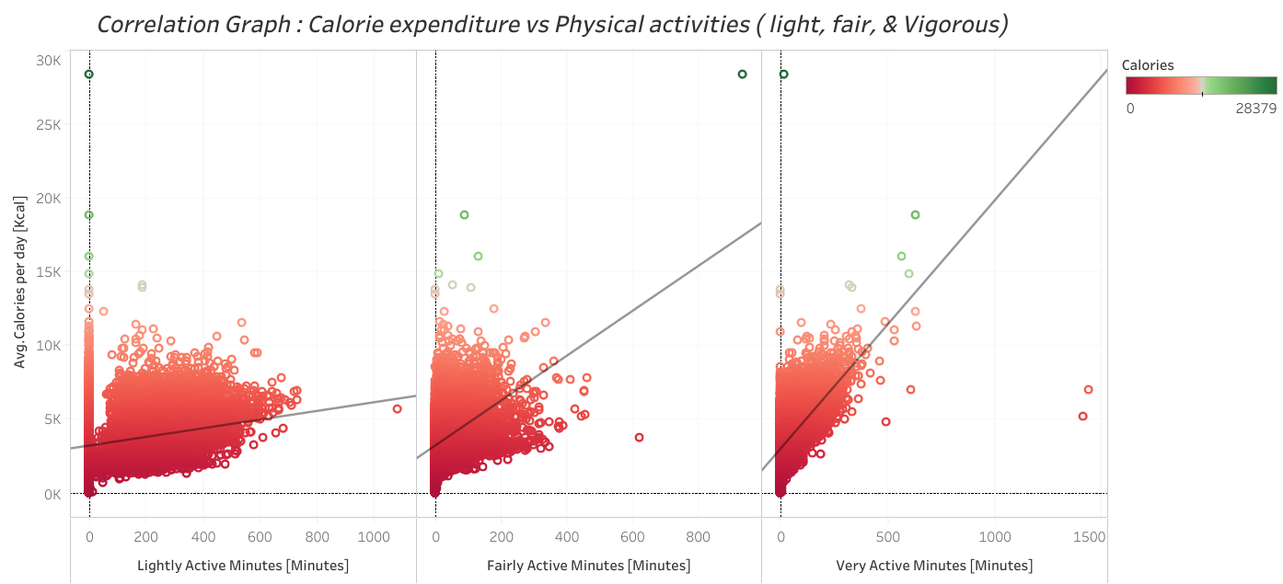

Slide 53

Analysis
There was positive correlation between calorie expenditure and all 3 categories of physical activities.
The correlation coefficient for light physical activity and step count was 0.3939 - weak.
The correlation coefficient for fair physical activity and step count was 0.4334 - weak.
The correlation coefficient for vigorous physical activity and step count was 0.6046 - good.
Strength of correlation increases with difficulty.
We can infer an increase in time spent during physical activity can lead to an increase in calorie expenditure .
Notes:
All correlation coefficients are weak ranging from 0.1 to 0.3

Slide 54
Aggregate Sleep activity over time

Slide 55
LEGEND
Sleep time: Total time in minutes in which participants were asleep - REM state
Laydown time: Total time in minutes in which participants were in bed, but not asleep
Time in bed: Total time in minutes in which participants were asleep and not asleep in bed
**Key findings: During the weekdays, with the exception of Wednesdays, participants averaged less than 7 hours ( 420 minutes ) of sleep time daily.

Slide 56
DAY OF WEEK

Slide 57
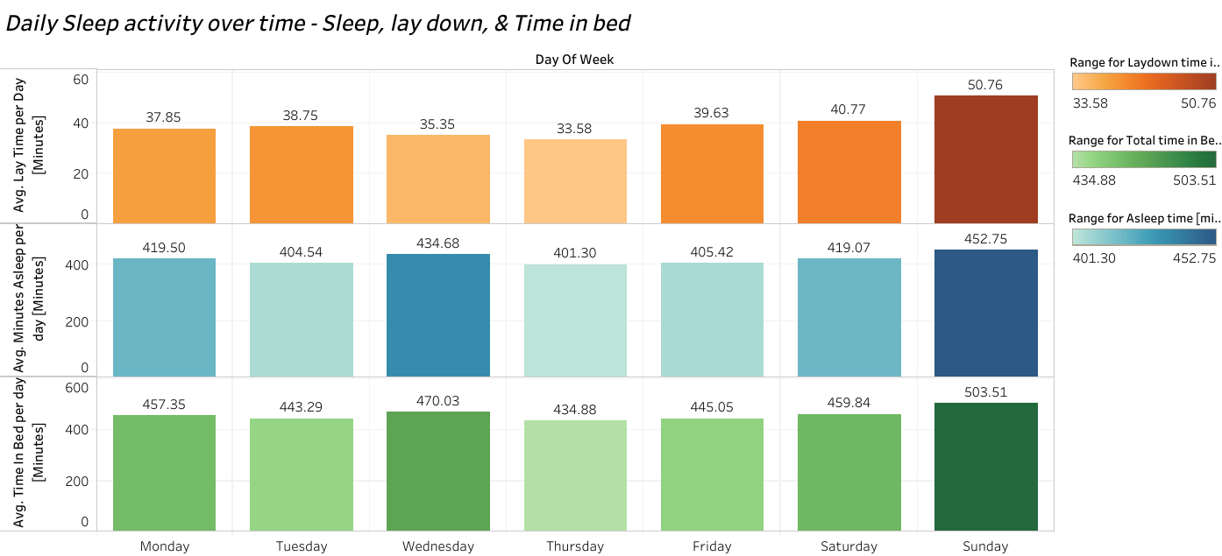

Slide 58
Analysis
DAILY
Participants spent the most time in bed on Sundays, and the least time in bed on Thursdays.
Participants spent the most time laying in bed on Sundays, and the least time laying in bed on Thursdays.
Participants spent the most time in asleep on Sundays, and the least time in asleep on Thursdays.
Notes:
All correlation coefficients are weak ranging from 0.1 to 0.3

Slide 59
Analysis
DAILY
Participants averaged 503.50 minutes (08:23:00) in bed on Sundays, and 434.87 minutes (7:14:00) on Thursdays.
Participants averaged 50.76 minutes (00:50:00) laying in bed on Sundays, and 33.57 minutes (00:33:00) laying in bed on Thursdays.
Participants averaged 452.74 minutes (07:32:00) asleep on Sundays, and 401.29 minutes (06:41:00) asleep on Thursdays.
Notes:
All correlation coefficients are weak ranging from 0.1 to 0.3

Slide 60
TIME OF DAY
HOUR OF THE DAY

Slide 61
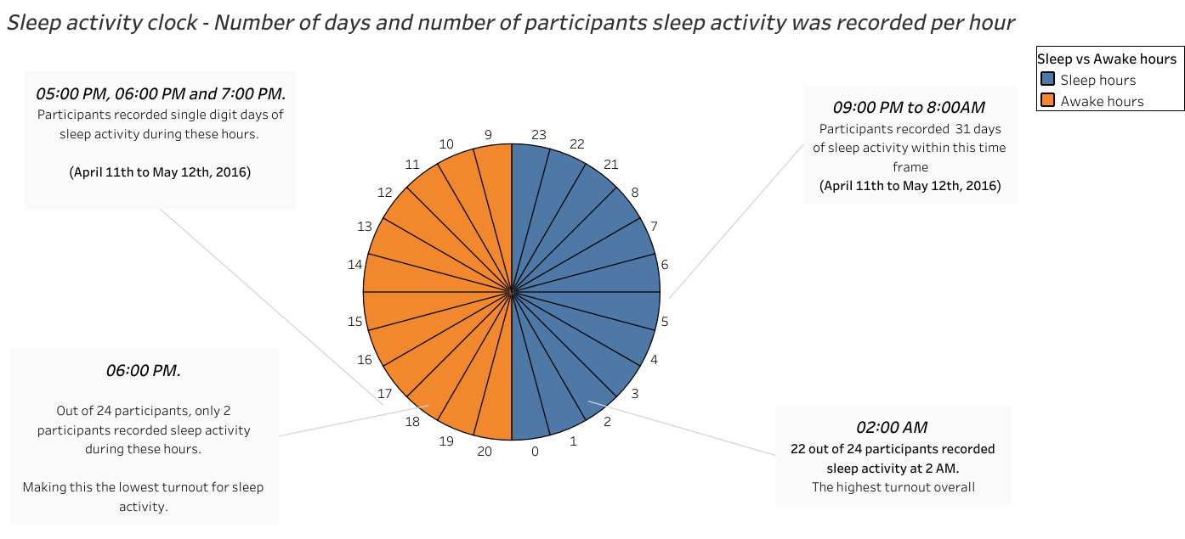
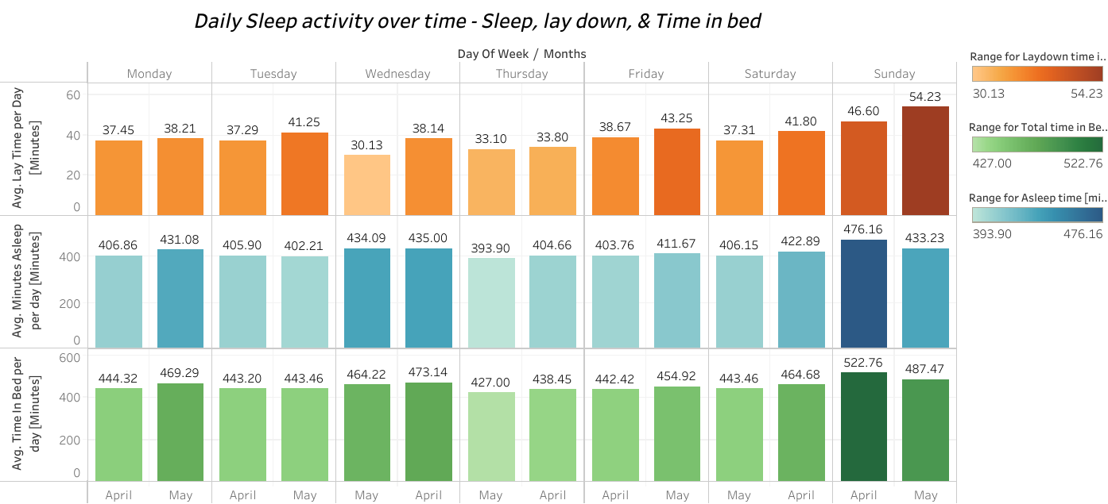

Slide 62
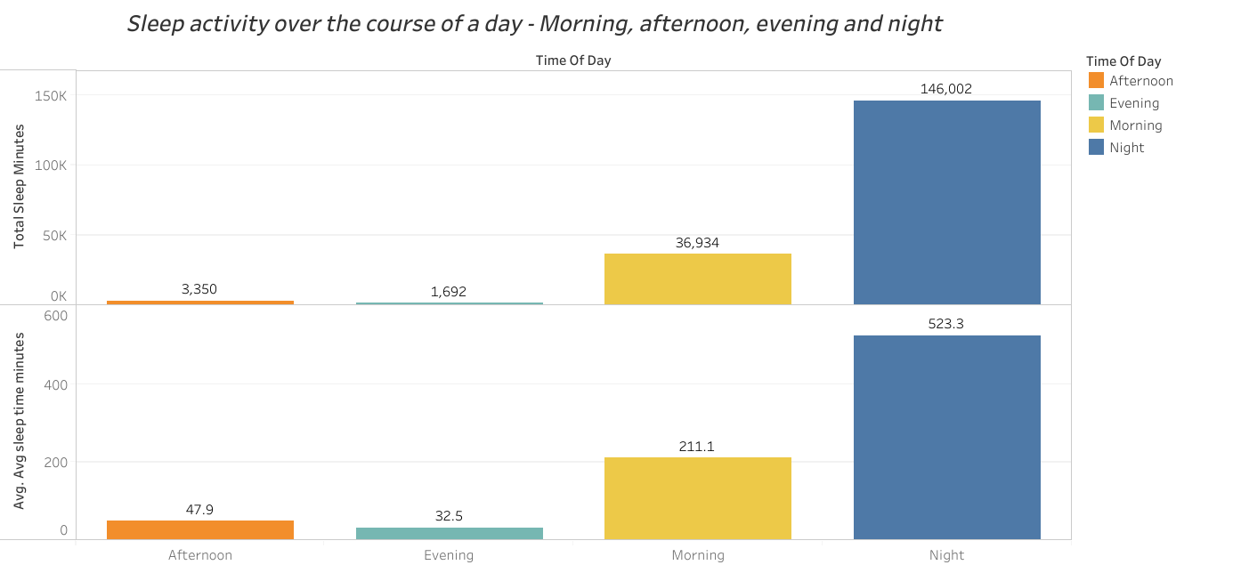
Analysis
TIME OF DAY/BY THE HOUR
Participants recorded the most time in bed/ sleeping/laying down at night (9PM to 6AM) when compared to other times of during the day.
The least time spent in bed/ sleeping/laying down was during the evening.
Notes:
All correlation coefficients are weak ranging from 0.1 to 0.3

Slide 63
Analysis

Slide 64
Analysis
Notes:
All correlation coefficients are weak ranging from 0.1 to 0.3

Slide 65
Aggregate
stress level/heart rate over

Slide 66
DAILY

Slide 67
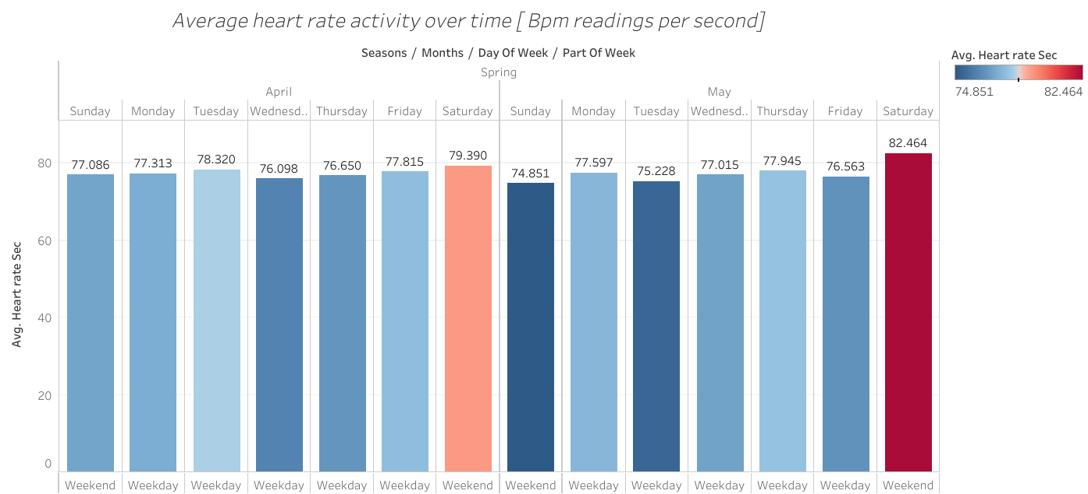
Analysis
DAILY
On Saturdays, participants recorded the highest average heart rate with a BPM of 79.97.
The lowest average heart rate was during Sundays with a BPM of 75.92.

Slide 68
TIME OF DAY

Slide 69
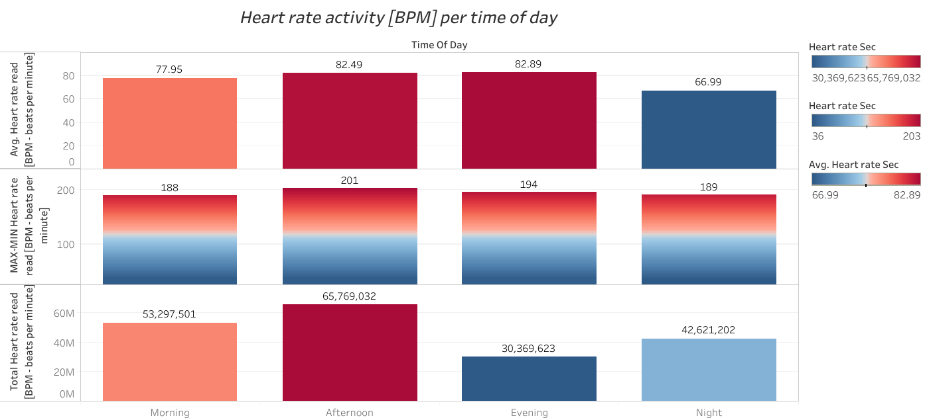
Analysis
TIME OF DAY/BY THE HOUR
Participants recorded the highest heart rate during the evenings, and lowest at night.
Participants record 82.89 BPM during the evenings, and 66.99 BPM at night.
Notes:
All correlation coefficients are weak ranging from 0.1 to 0.3

Slide 70
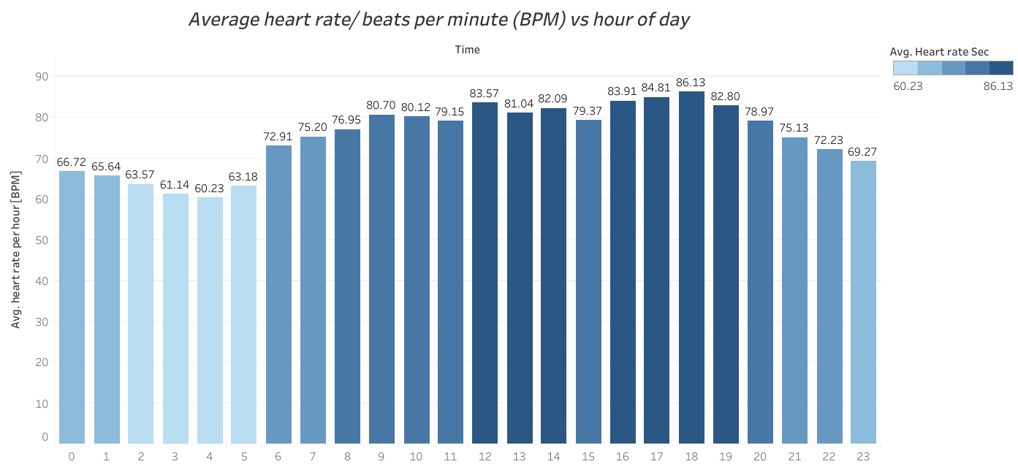
Analysis
TIME OF DAY/BY THE HOUR
Low heart rate throughout the night, but begins to rise in the morning (6:00AM).
Heart rate peaks at 12:00PM noon (83.57) BPM, then begins to drop in the afternoon.
Heart rate starts to rise at 4:00PM and peaks at 6:00PM (86.13)BPM. It gradually drops throughout the evening into the night.
Notes:
All correlation coefficients are weak ranging from 0.1 to 0.3

Slide 71
Is stress level/heart rate related to sedentary time, calorie expenditure or step count - both of which would be considered as physical activity?

Slide 72
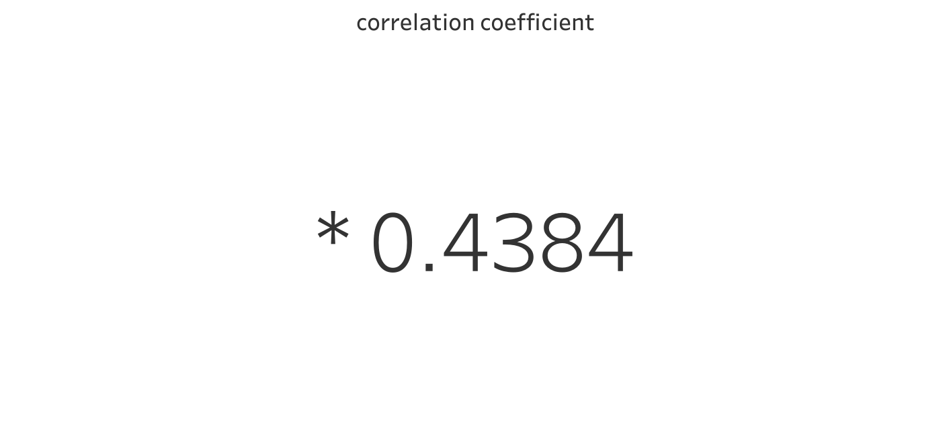
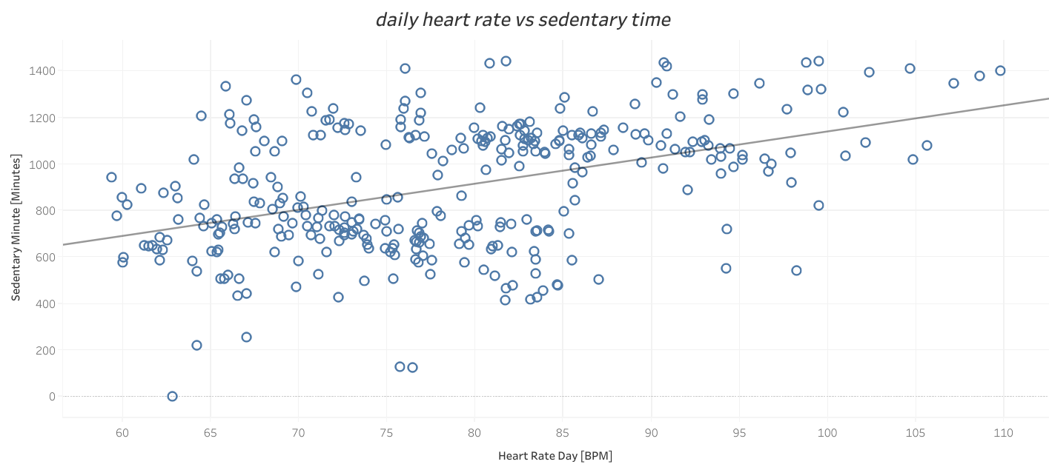

Slide 73
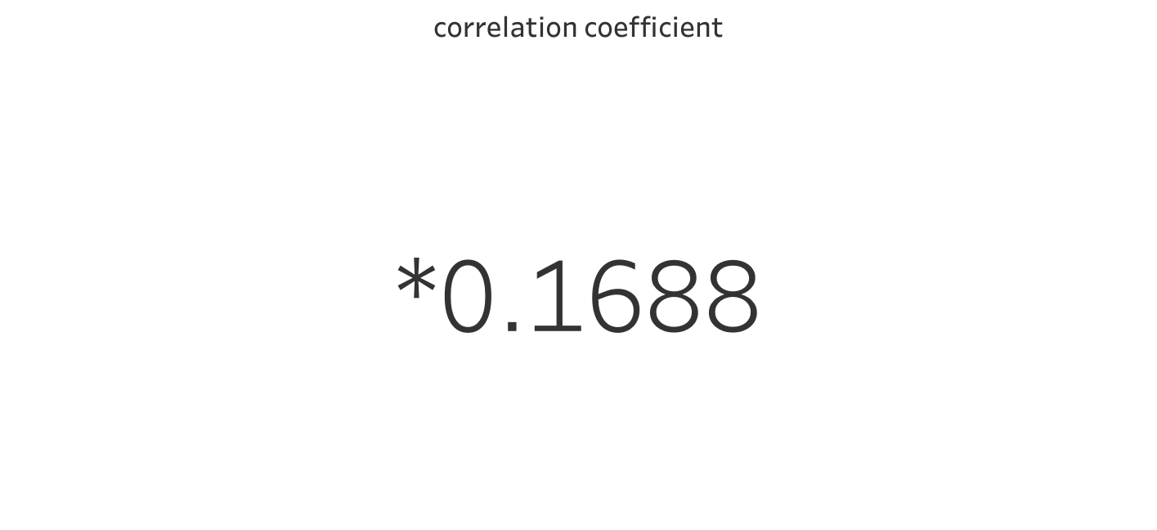
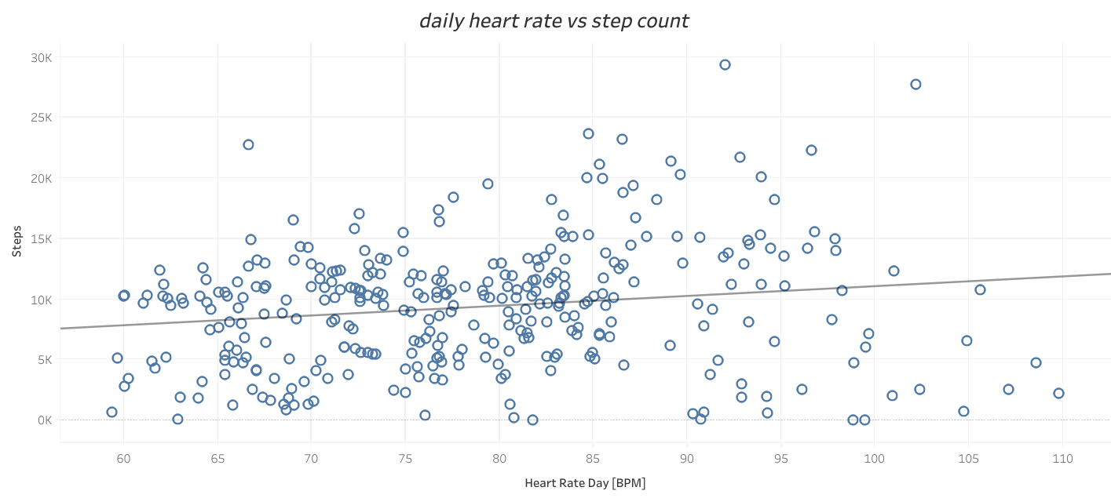

Slide 74
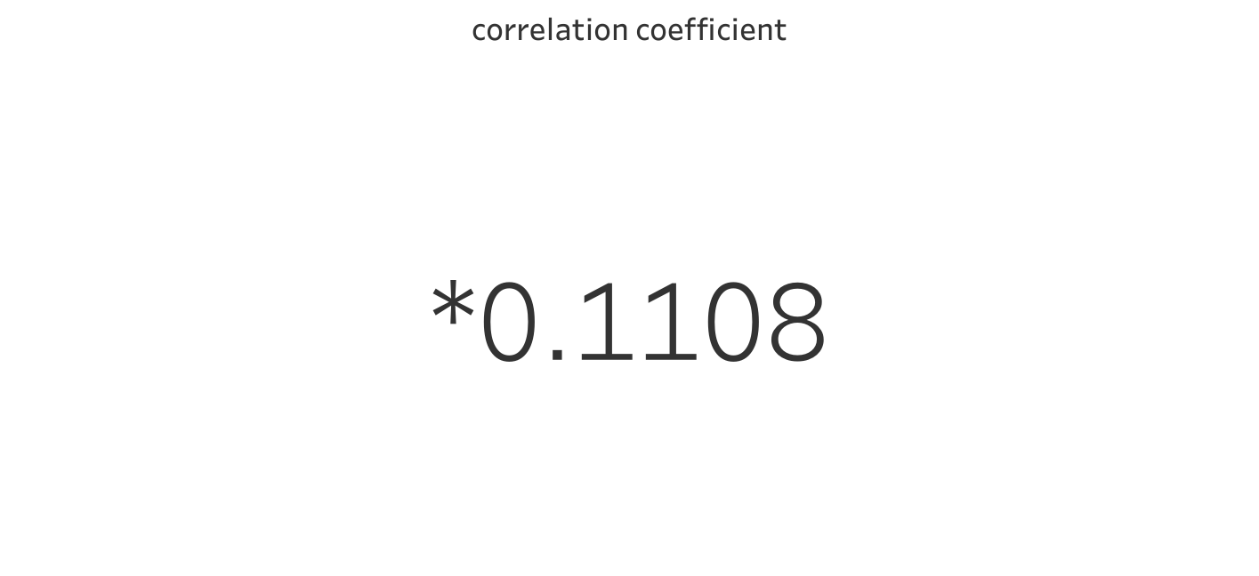
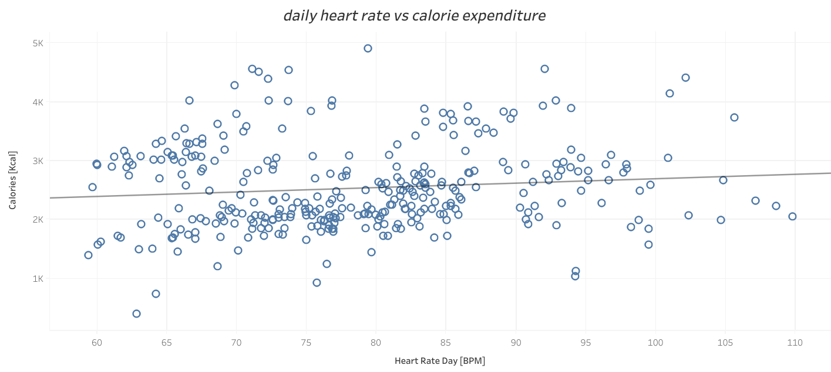

Slide 75
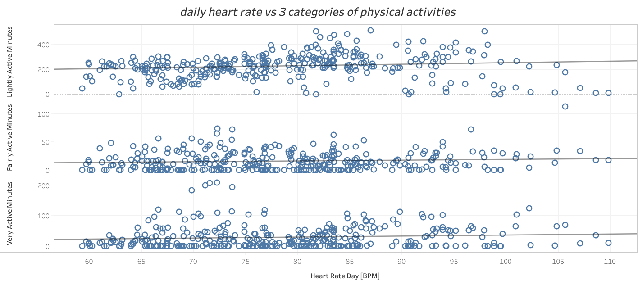
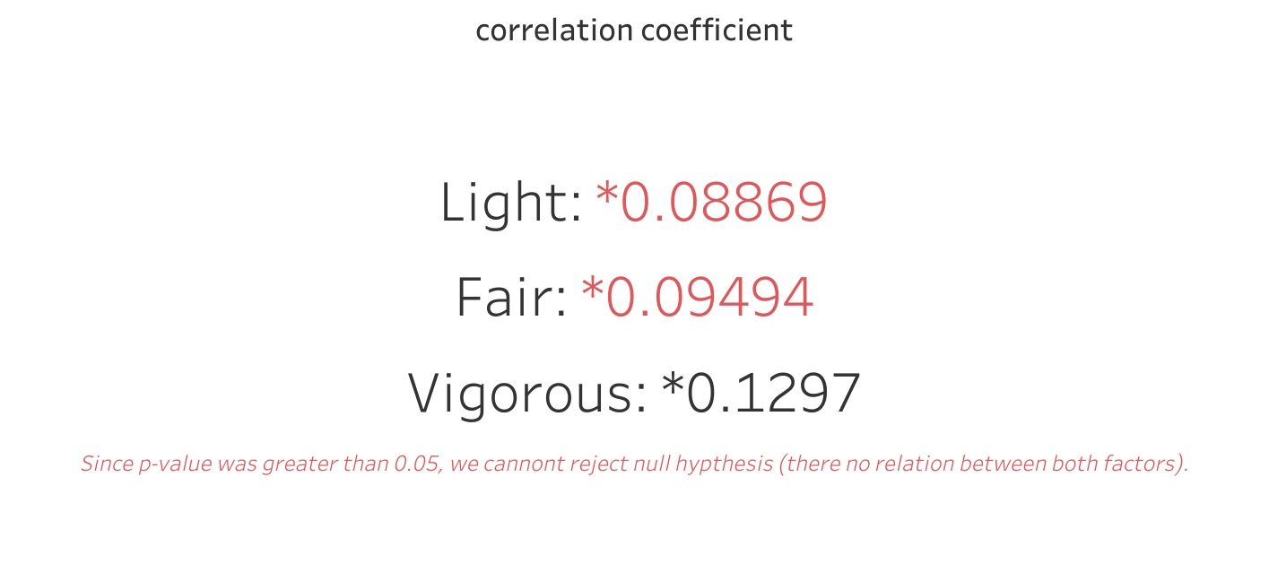

Slide 76
Our graphs show no correlation between heart rate activity and fairly/vigorous physical activities.
There was a positive correlation between heart rate and sedimentary time/steps/calorie expenditure/light physical activities. However, the correlation coefficient amongst all 4 factors was less than 0.5.
We can infer a positive relation exists between heart rate and the 4 factors ( sedentary,steps, calories, physical activities - light,fair, vigorous), but that relation is weak.

Slide 77
Marketing recommendations

Slide 78

Recommendations
1
2
3
The leaf fitness tracker alongside the bellabeat app could be used in conjunction to educate customers on common health related practices using our findings. They can then use this data to create and meet their health goals.
The leaf can be applied on the wrist as a bracelet, on the neck as a necklace,and on hair or clothing as a clip. Not only does it serve as a fitness and health tracker, we can market its stylish design to our fashion conscious audience.
Based on physical, sedentary, and sleep activity, our target audience should be towards working class individuals who work during weekdays.

Slide 79
Recommendations
4
5
6
We should advertise the leaf during the Summer ( June, July, August) period as this was when participants engaged in the most step count, calorie expenditure, and physical activity.
Saturdays are when participants tend to be most active and Sundays are when sleep activity is highest, so we should advertise the leaf fitness tracker on the weekends.
For current users, I recommend we create fitness communities using the leaf fitness tracker and app. Users can share and gain knowledge of health goals and activities with others. Weekly challenges and games could encourage current users to increase usage of the leaf.
To expand on the 5th recommendation, we can do the following:
For weekly or monthly challenges, we can set interval points throughout the day at 12 noon and 6pm ( data shows this is when participants peak in heart rate/calorie expenditure/ step count), and on the weekends (Saturdays are when participants tend to be most active and Sundays are when sleep activity is highest)

Slide 80
Limitations
The sample size for stress level and sleep activity was low - there were only 14 unique IDs available for the analysis.
Some excel files had daily readings for 31 days, while others had daily recordings for 2 years. There will be inconsistencies with the overall results.
I noted earlier some participants did not wear their tracker for the entirety of the study, hence we had some zero value entries.
Although heart rate was high in the evenings, our analysis cannot infer it is a result of solely physical activities, step count or calorie loss. Other factors not accounted for could be the issue.

Slide 81
Appendix
Fanaee-T, Hadi, and Gama, Joao, 'Event labeling combining ensemble detectors and background knowledge', Progress in Artificial Intelligence (2013): pp. 1-15, Springer Berlin Heidelberg
Massoomi MR, Handberg EM. Increasing and Evolving Role of Smart Devices in Modern Medicine. Eur Cardiol. 2019;14(3):181-186. Published 2019 Dec 18. doi:10.15420/ecr.2019.02
Science Soft (n.d.). Smart Medical Devices: Software Architecture, Features, and Tech Stack. Science Soft Professional Software Development. https://www.scnsoft.com/healthcare/medical-devices/smart#market-overview
Henriksen, André; Johannessen, Erlend; Hartvigsen, Gunnar; Grimsgaard, Sameline; Hopstock, Laila Arnesdatter, 2021, "Replication Data for: Dataset of Consumer-Based Activity Trackers as a Tool for Physical Activity Monitoring in Epidemiological Studies During the COVID-19 Pandemic", https://doi.org/10.18710/TGGCSZ, DataverseNO, V3
Liu, Yong, et al. "Prevalence of healthy sleep duration among adults—United States, 2014." Morbidity and Mortality Weekly Report 65.6 (2016): 137-141. ( sleep notes)

